Slide 1
Sport tracker application
IS3020 - Application Development - Project
Kyle Bender
December 9, 2019

Slide 2
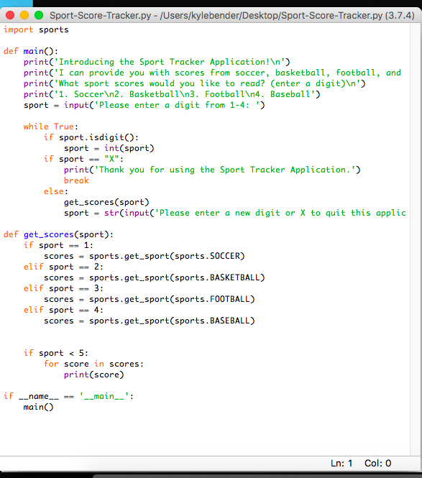
Sport score tracker application
Member(s): Kyle Bender
Concept: Receive scores from basketball, baseball, soccer, and football games of the given day.

Slide 3
Code Breakdown
The code started with basic print statements welcoming the user the Sport Tracker Application.
It would then prompt you to pick a digit 1-4 based upon what sport scores you would like to read from the given day.
The #1 was assigned to soccer scores, #2 was basketball, #3 to football, and #4 to baseball.
After reading your scores, there was an option to type another digit to read other sport scores or type “X” to quit the application.
After quitting, a print statement was constructed to thank the user for using this application.

Slide 4
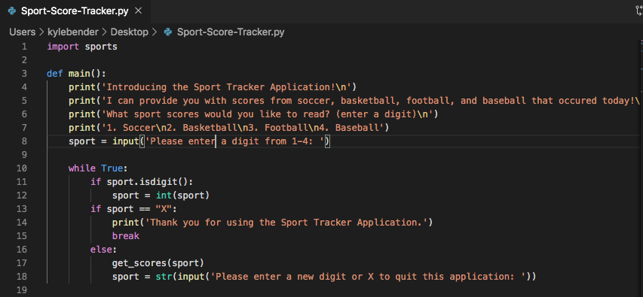
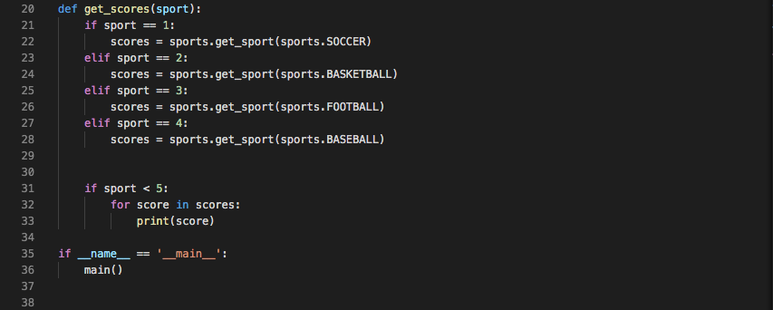
Code Breakdown

Slide 5
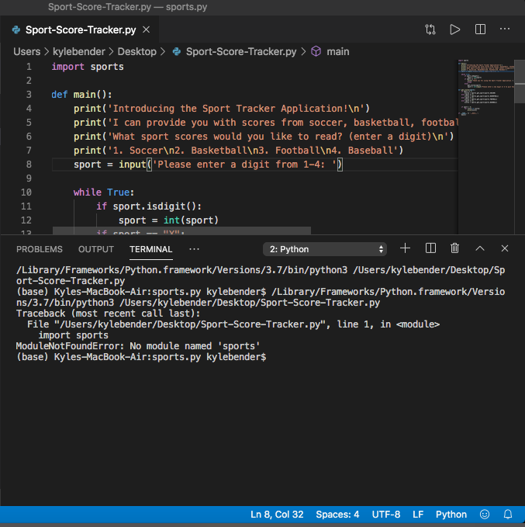
Errors
Unfortunately the code I constructed was not able to run properly.
The only error message that would occur, after running the python file in the terminal, was “No module named ‘sports’”
The first line of code was directly involved with importing the module sports.
Knowing that this was a customized module beforehand would have helped my code to run correctly.
I was not able to correctly install the custom module because there were aspects of the module installation that were beyond my current skillset.

Slide 6
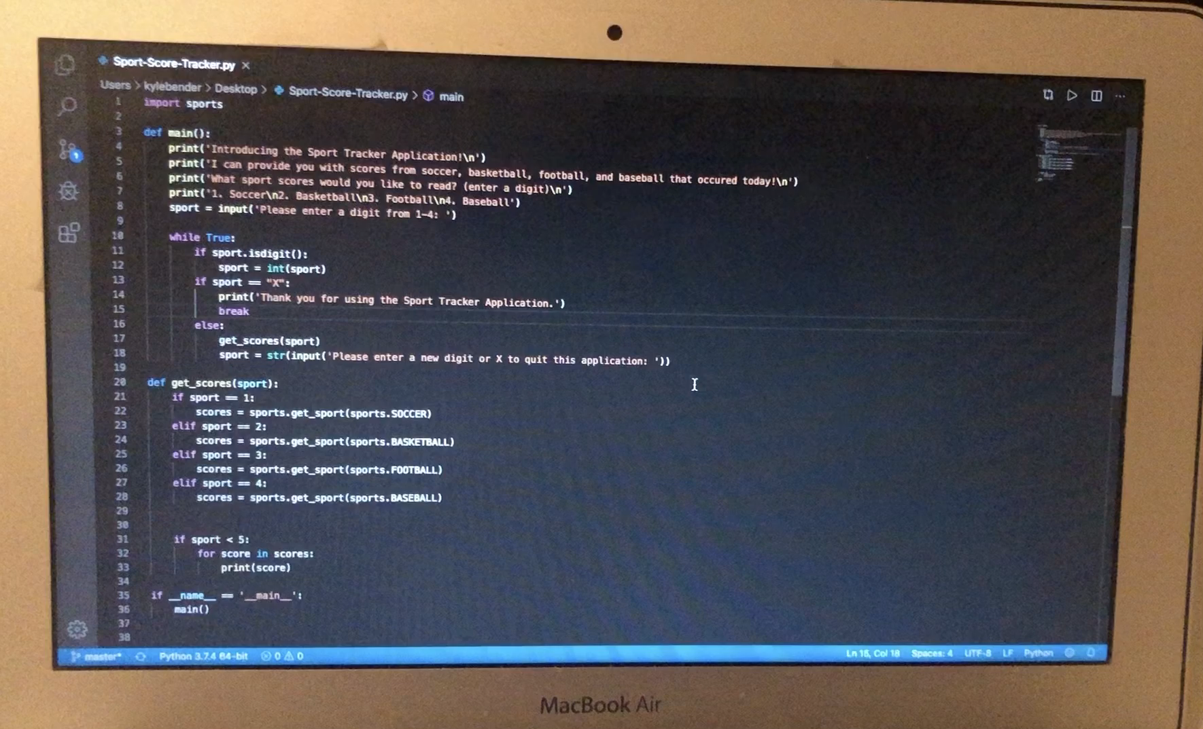
Demonstration

Slide 7

My Thoughts

